Slide 1
EXPANDED USE CASES
By – Kanaga Manikandan Solaikannan

Slide 2
What are expanded use cases?
Expanded Use Case is a detailed description of the processes used to complete various system functions.
We’ll be covering on how expanded use cases were used to identify requirements and organise the management of the software development exercise.
We’ll also be covering on how it provided more knowledge than that of an existing use case diagram.

Slide 3

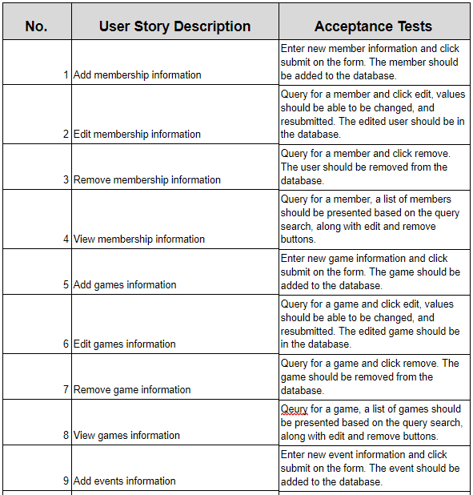
How did it help identify requirements?
The functions and processes of the system software were derived from the user stories of this project.
From these functions, the team was able to categorise each function into primary and secondary functions.
Primary functions are those which are very essential to the software product. Secondary functions are those which will help the user to perform extra features.
Notes:
3rd point – The software will still work even without the secondary functions.

Slide 4
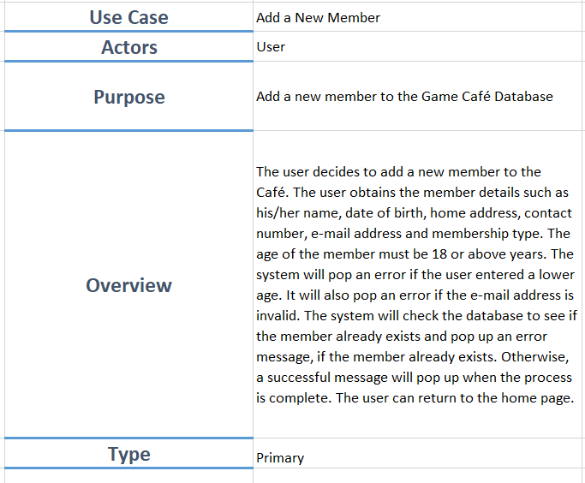
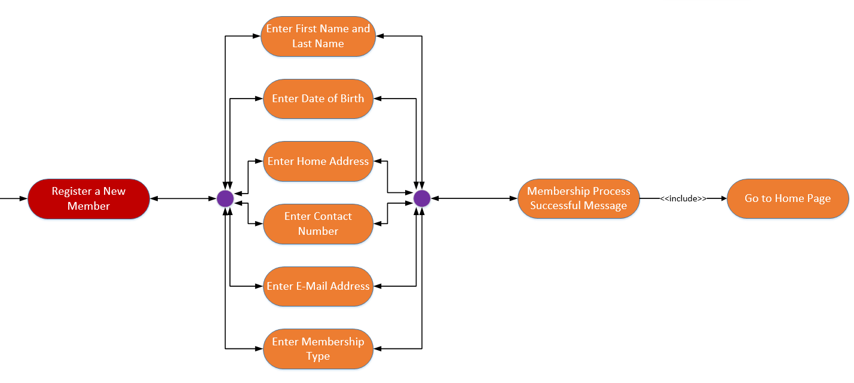
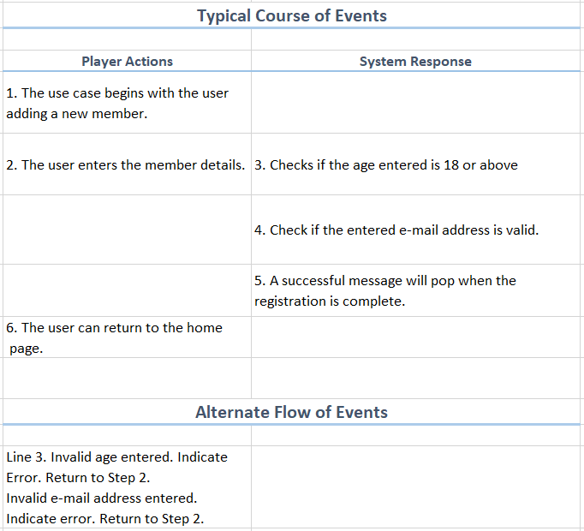
use case diagram to expanded use case
The use case diagram provided a clear visual flow but was unable to describe some steps in more detail.
If more features were to be added, the diagram becomes more cluttered and will only get bigger.
Thus, expanded use cases were created to obtain an in-depth knowledge of these functions.

Slide 5
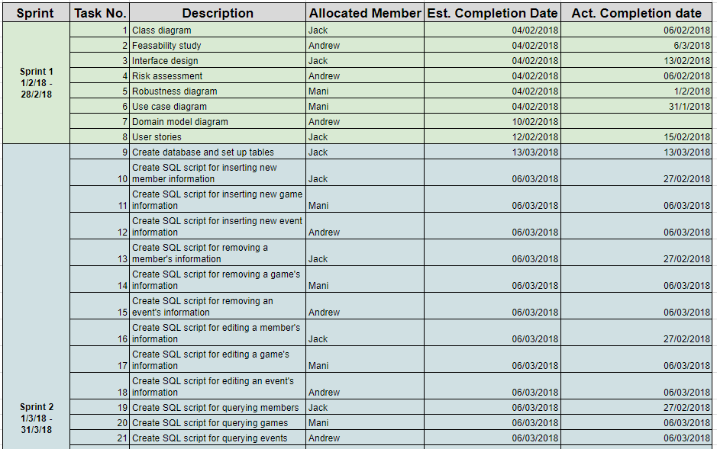
How did it help organise?
The detailed description from the expanded use case helped the team to sort out the weight of the tasks and assign them to each member equally.
The typical course of events enabled the team to understand the flow of processes in more detail and structure the query appropriately.
Notes:
2nd point – The typical course of events [from the expanded use case] enabled

Slide 6
References
http://www.comptechdoc.org/independent/uml/begin/umlexusecase.html

